Slide 1

PROJECT NBI USING DBEAVER TOOL

Slide 2
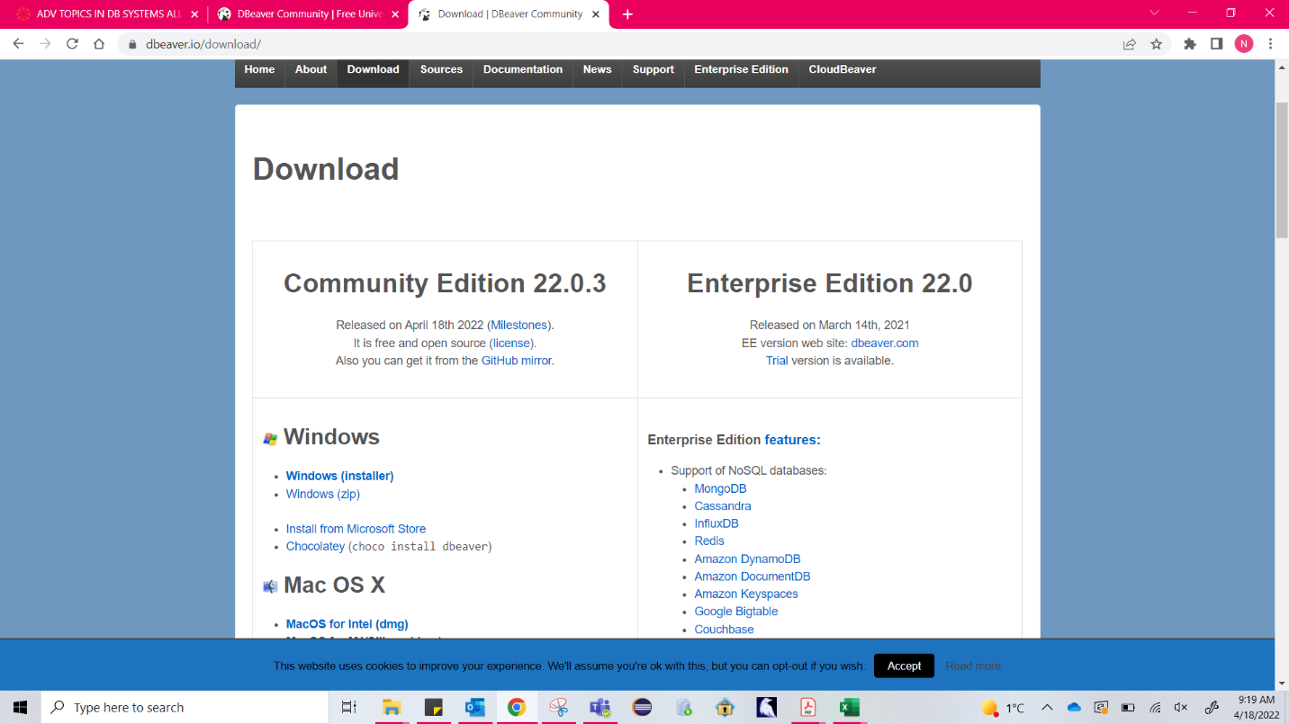
DBeaver Installation:

Slide 3
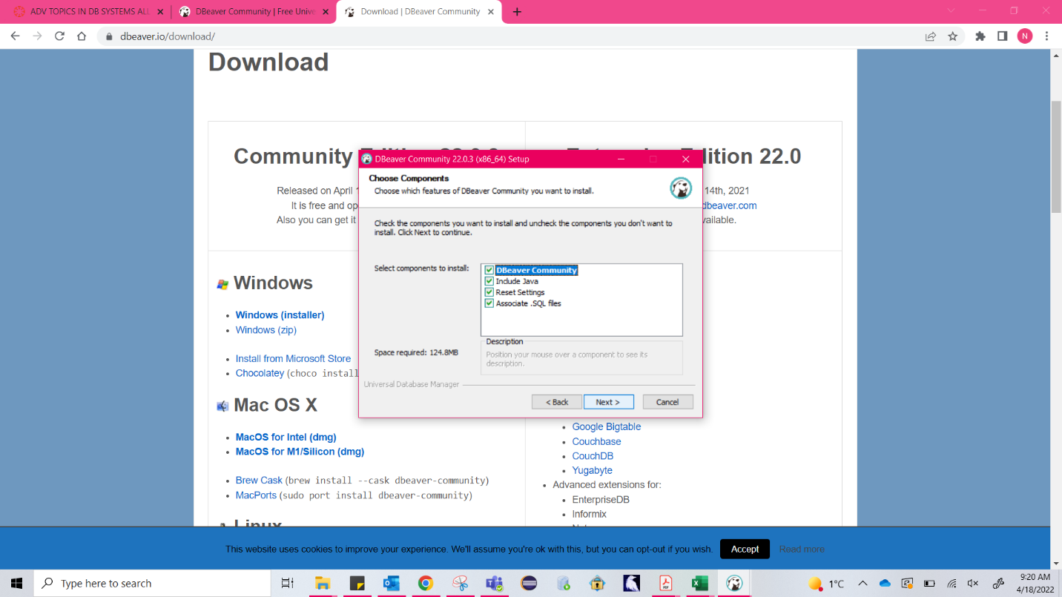
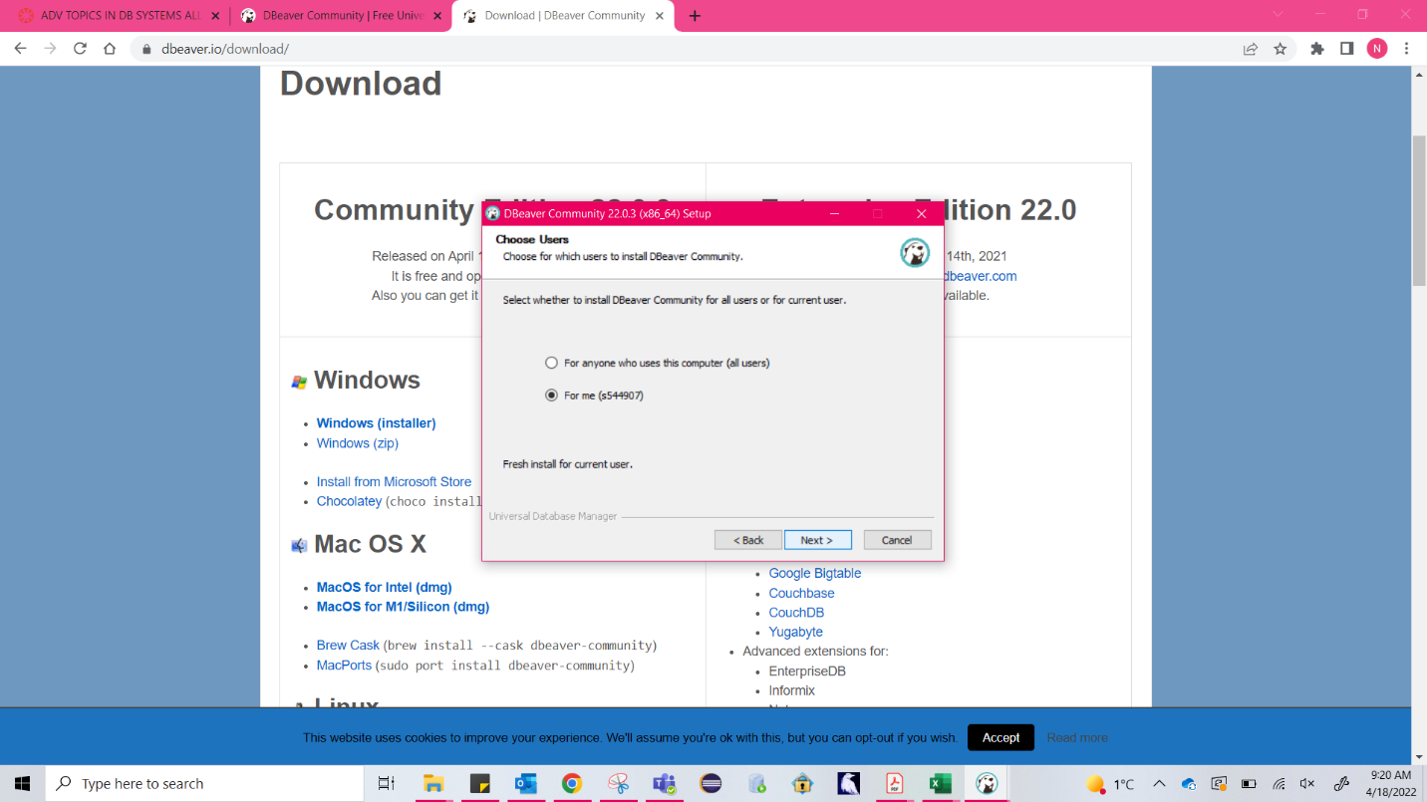
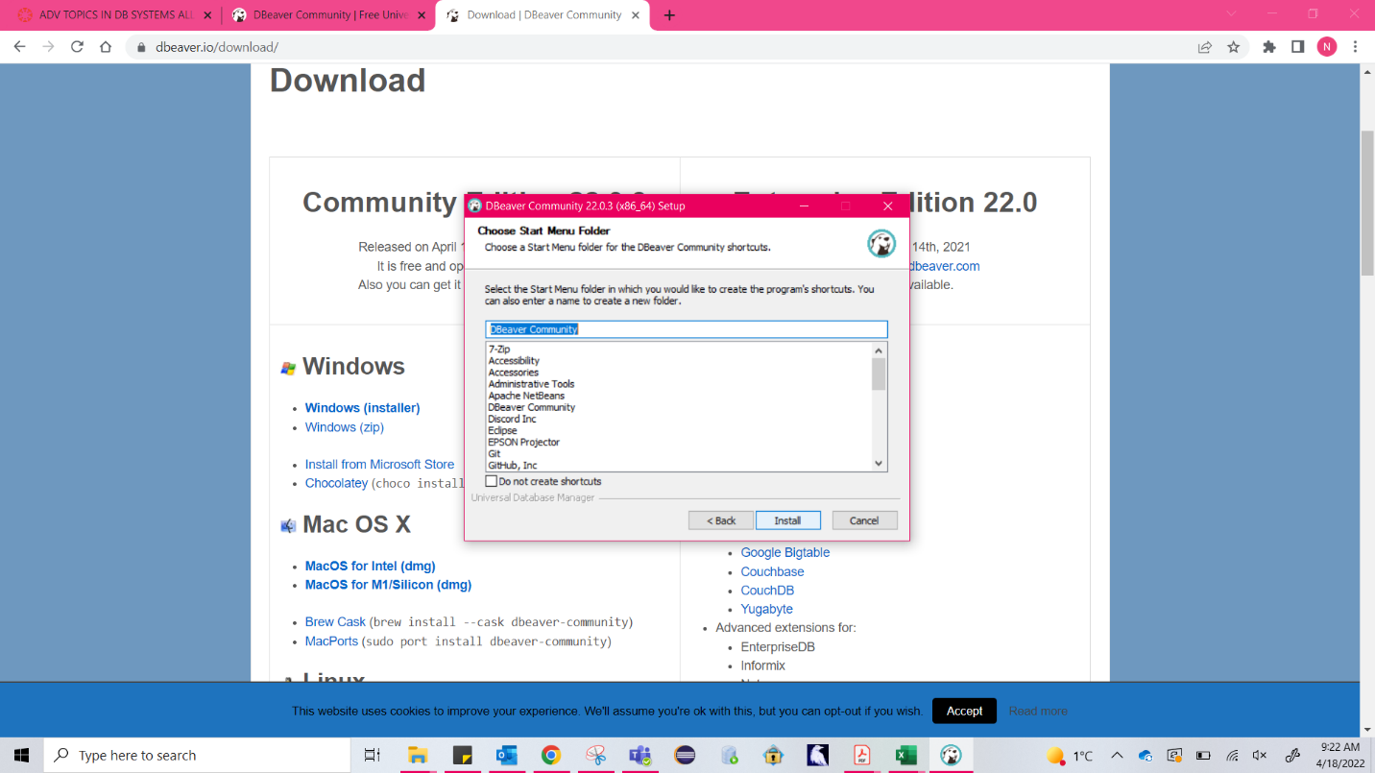

Slide 4
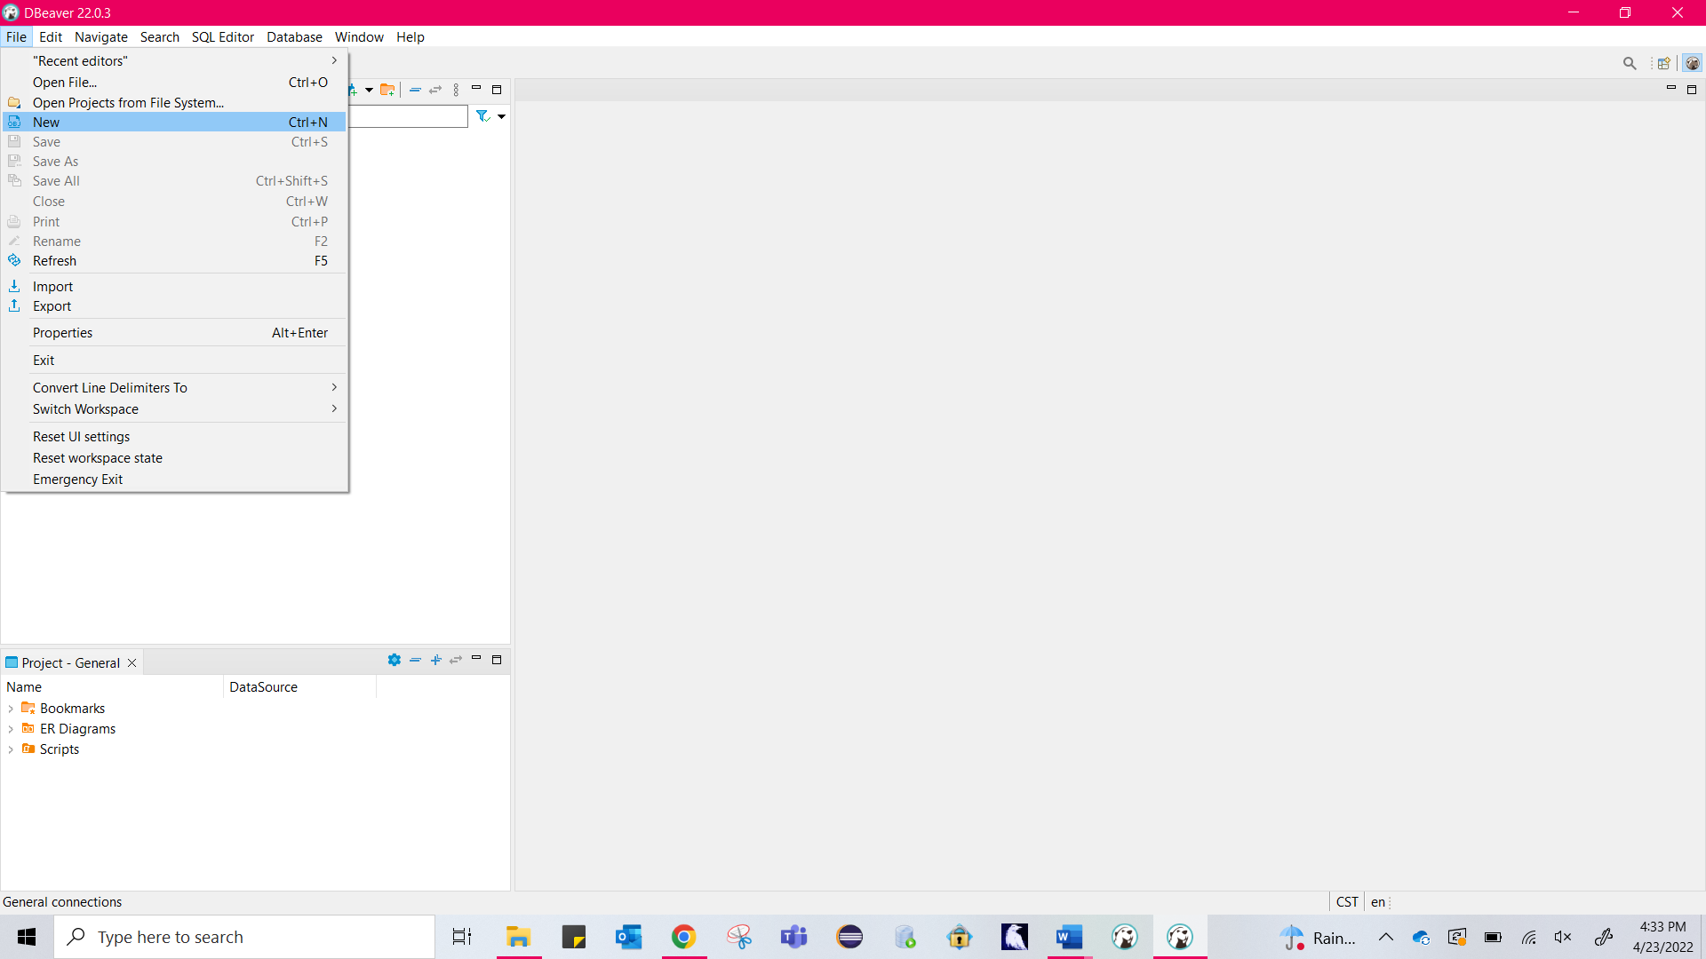
How to create a project in Dbeaver:

Slide 5
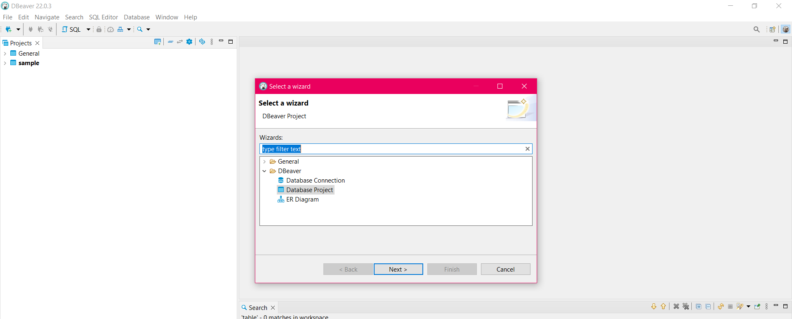
Select database project

Slide 6
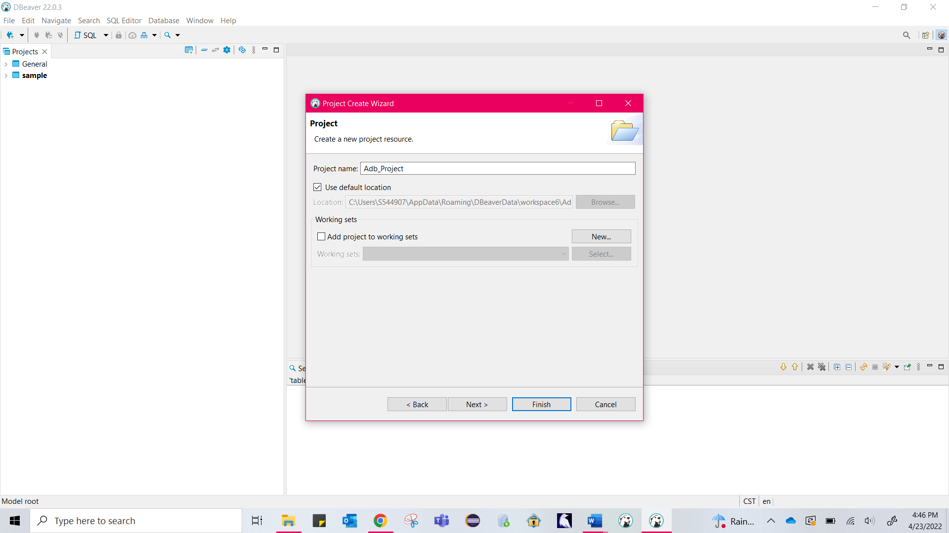
Give project Name:

Slide 7
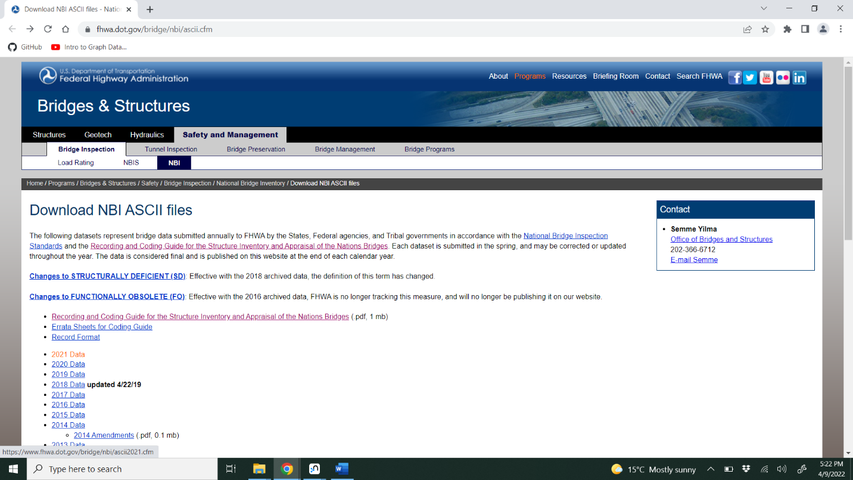
Download respected NBI dataset files from the nbi portal

Slide 8
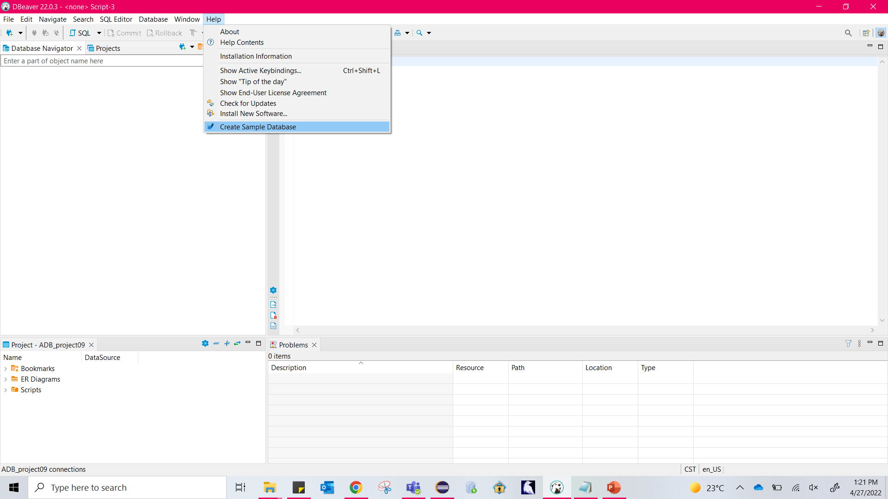
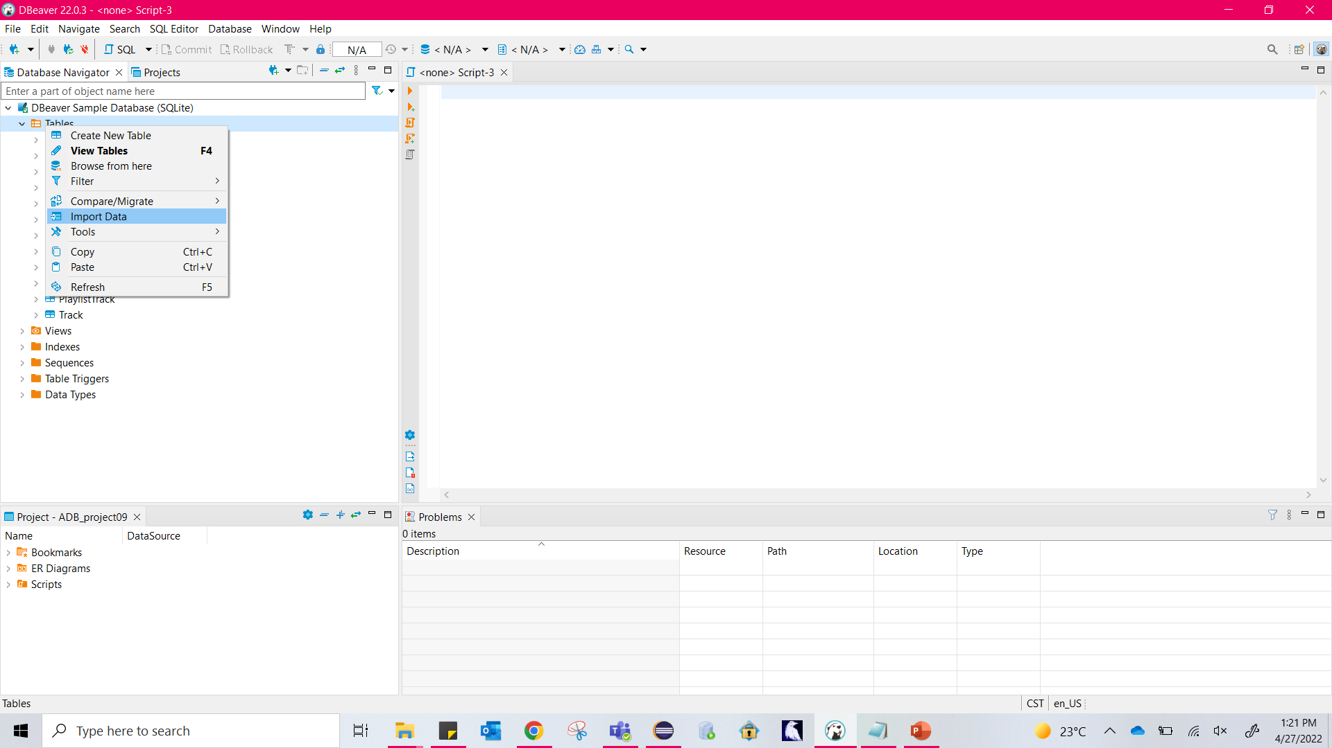
You can manually create sample database by clicking on help and import data i.e., the respected nbi files in either csv/txt format.

Slide 9
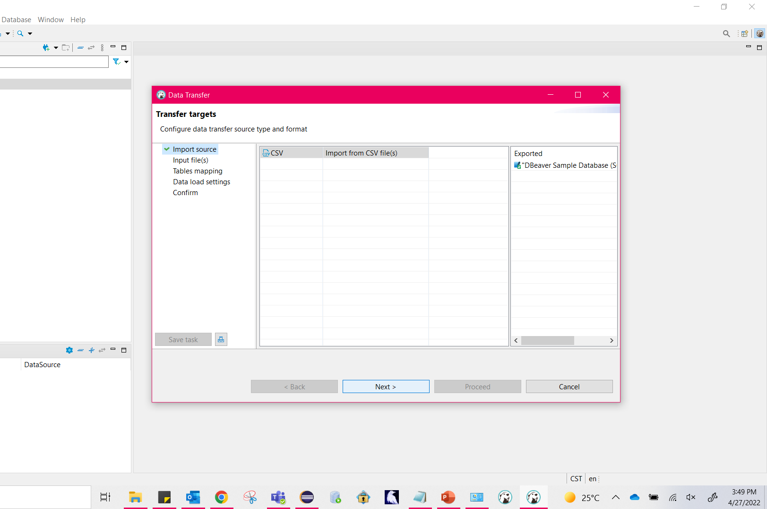

Slide 10
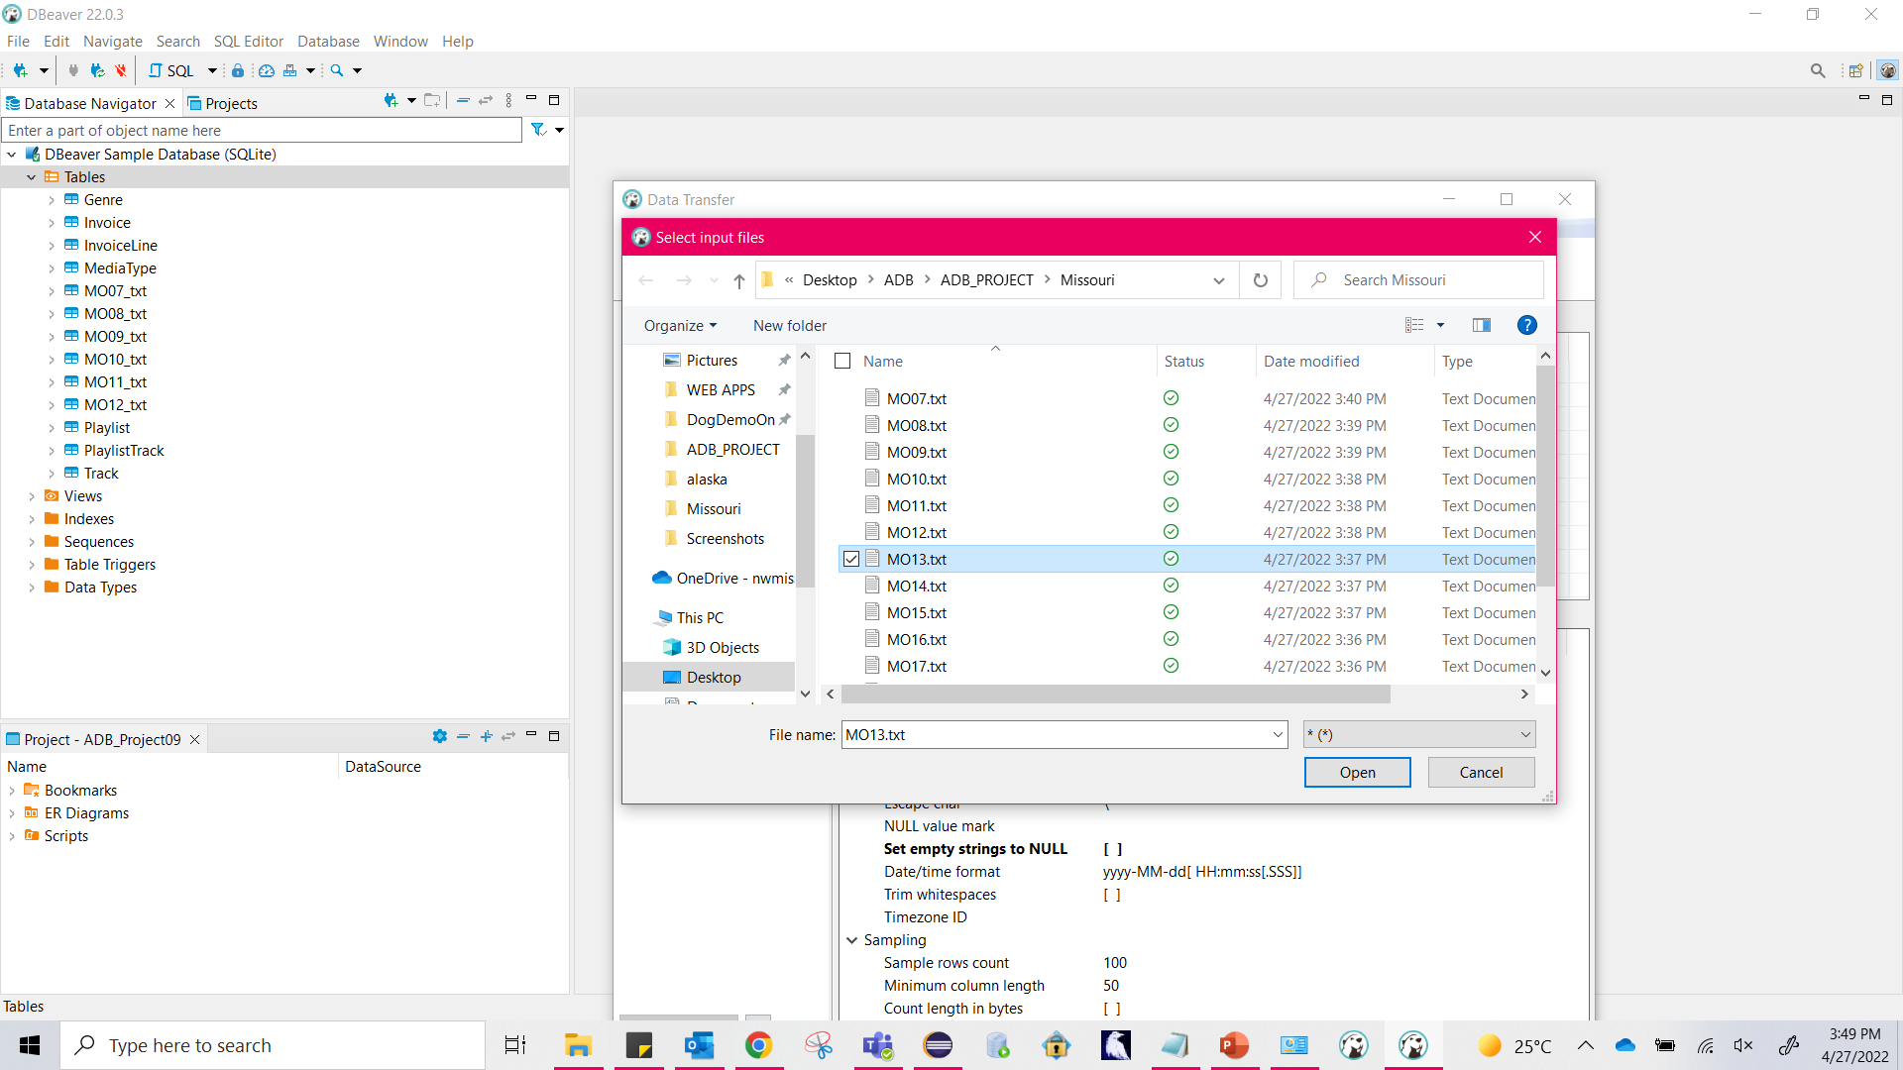
Import respective data files to the tables.

Slide 11
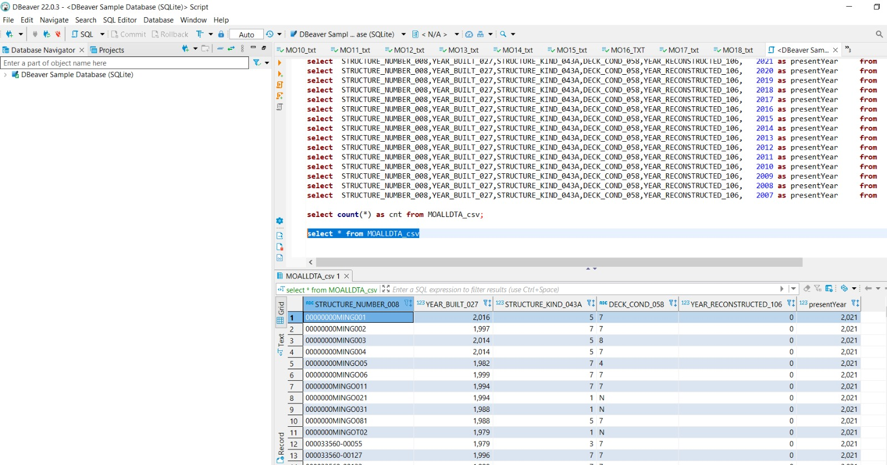
Query 2 result : Combined bridge data of 2007 to 2021

Slide 12
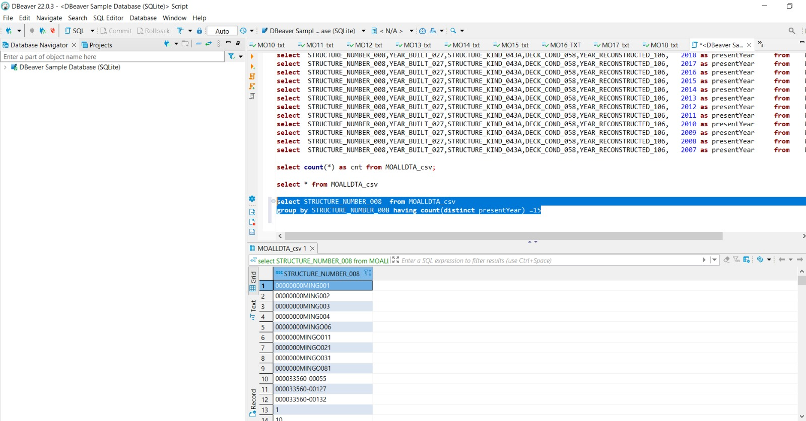
Query 3 , part 1:common bridges of 15 years

Slide 13
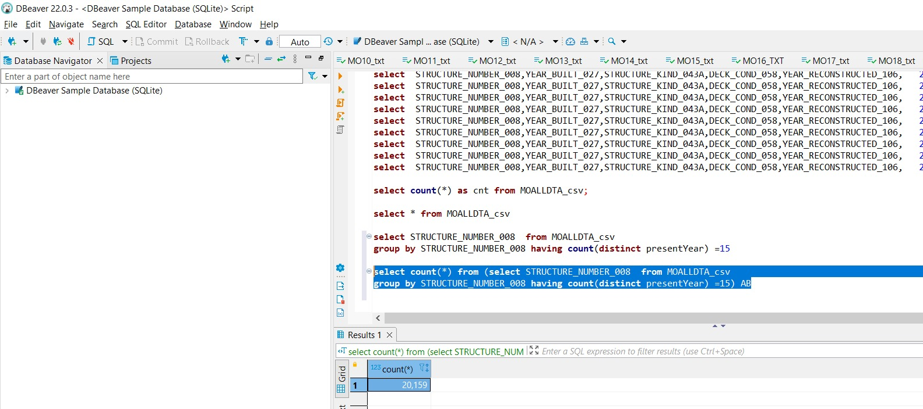
Query 3 , part2 :count of common bridges in 15 years is 20,159.

Slide 14
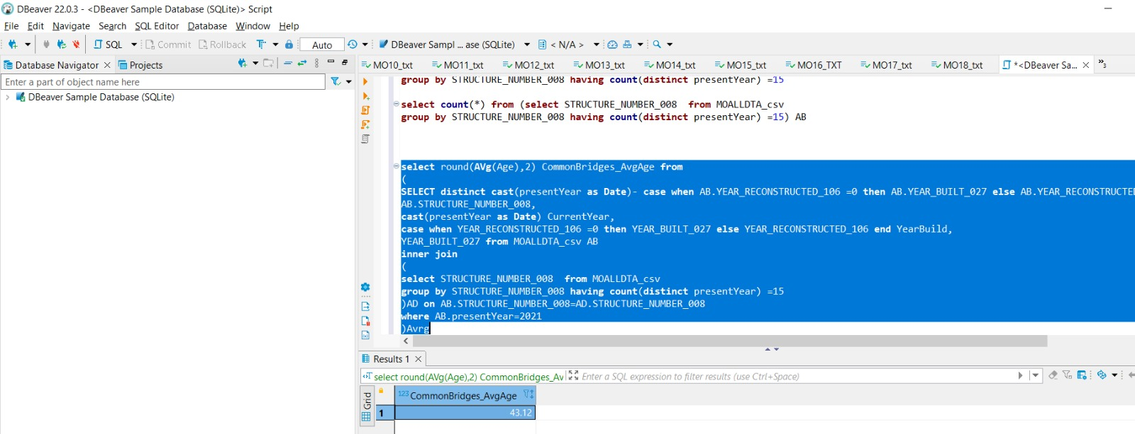
Query4 , part 1 : Average age of common bridges: 43.12

Slide 15
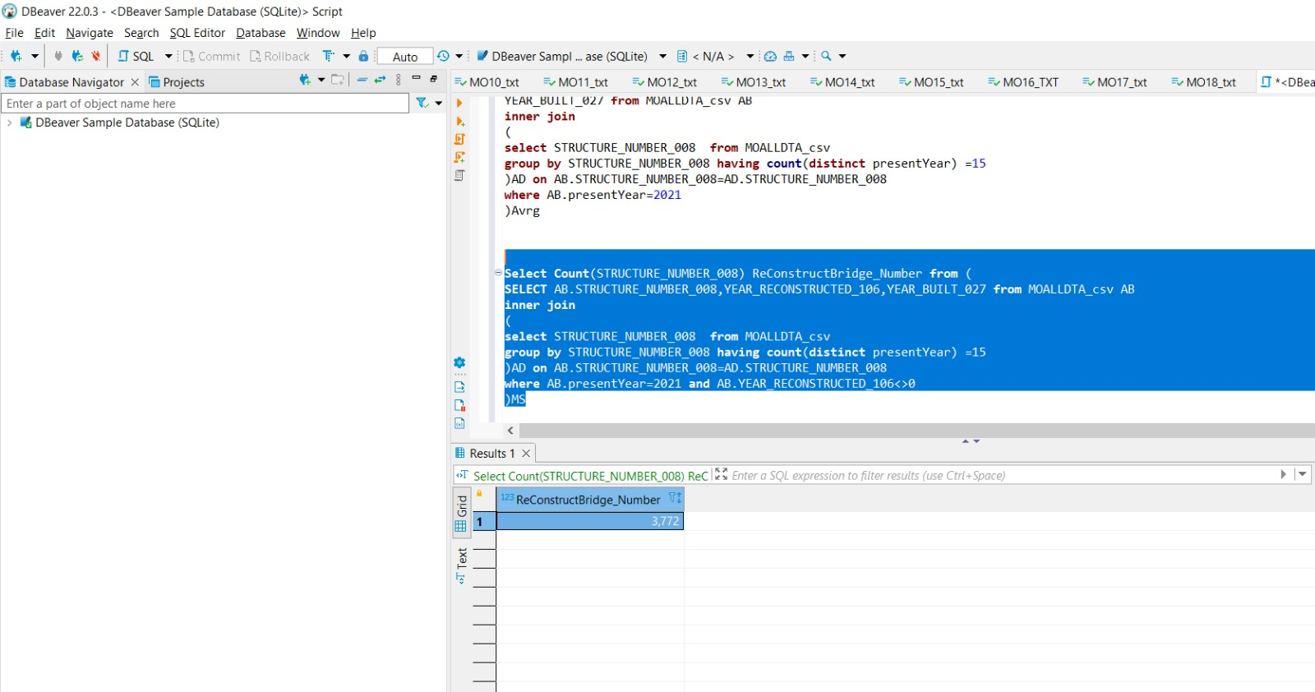
Query4, part 2 : count of reconstructed bridges in common bridges is 3772.

Slide 16
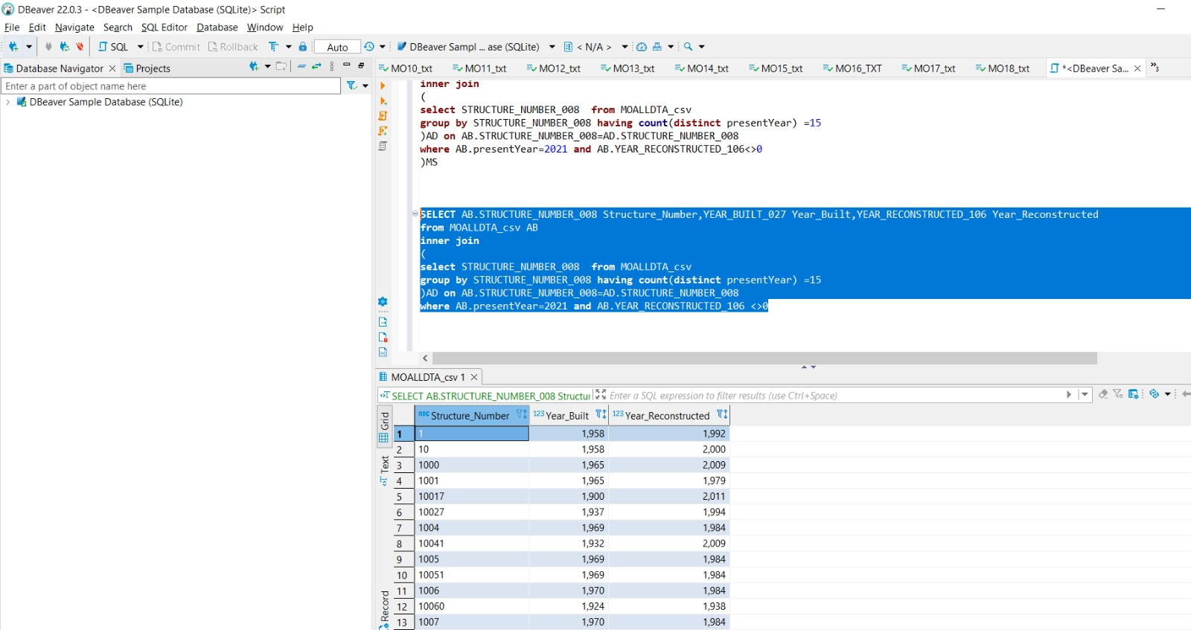
Query4, part 3: Structure number , year built and year reconstructed of above bridges

Slide 17
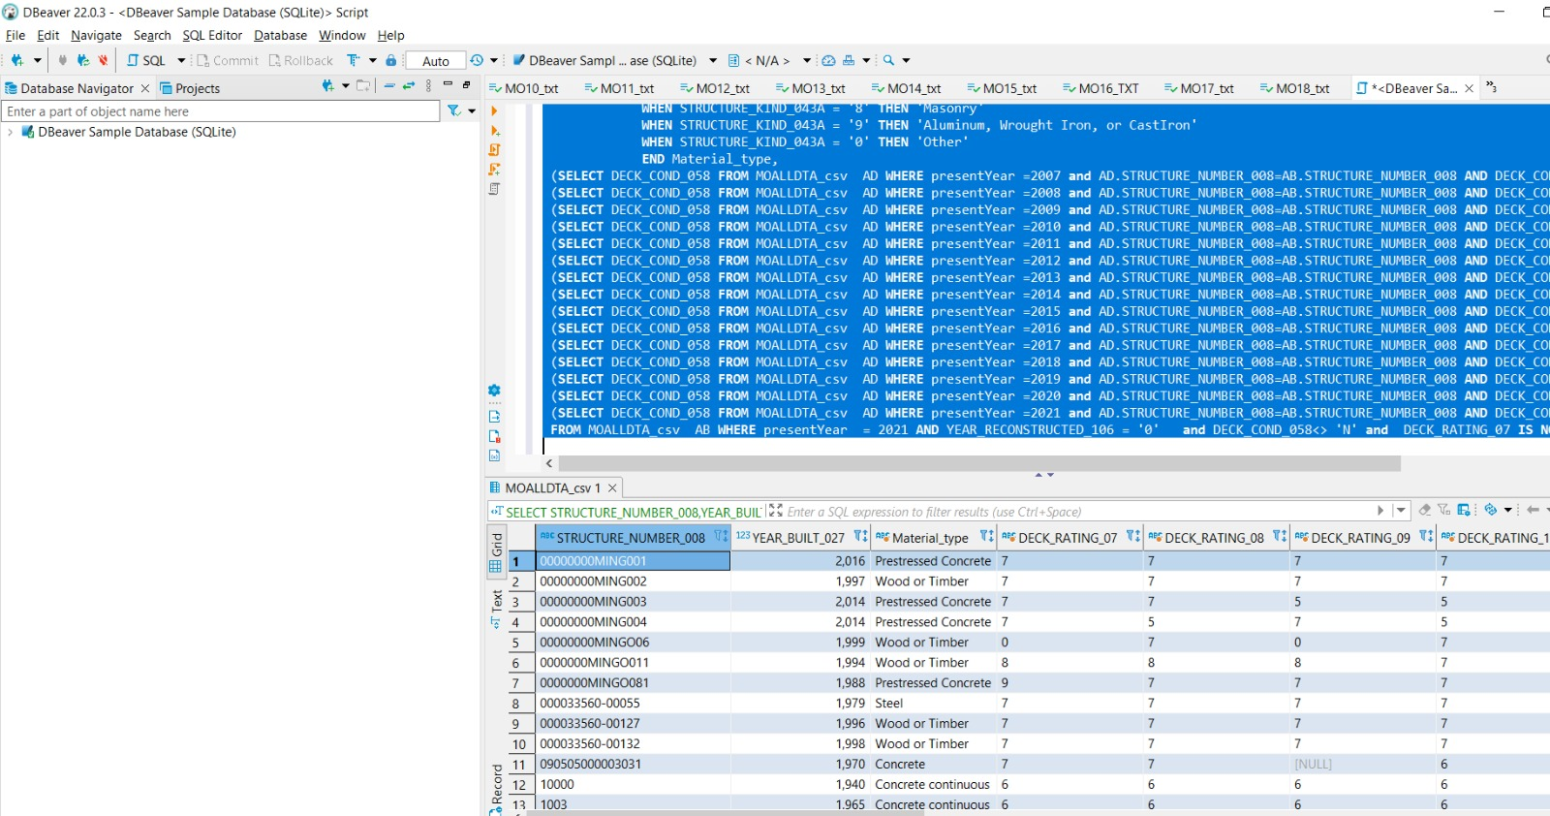
Query5 : Structure number , material used , deck ratings of bridges which are not reconstructed

Slide 18
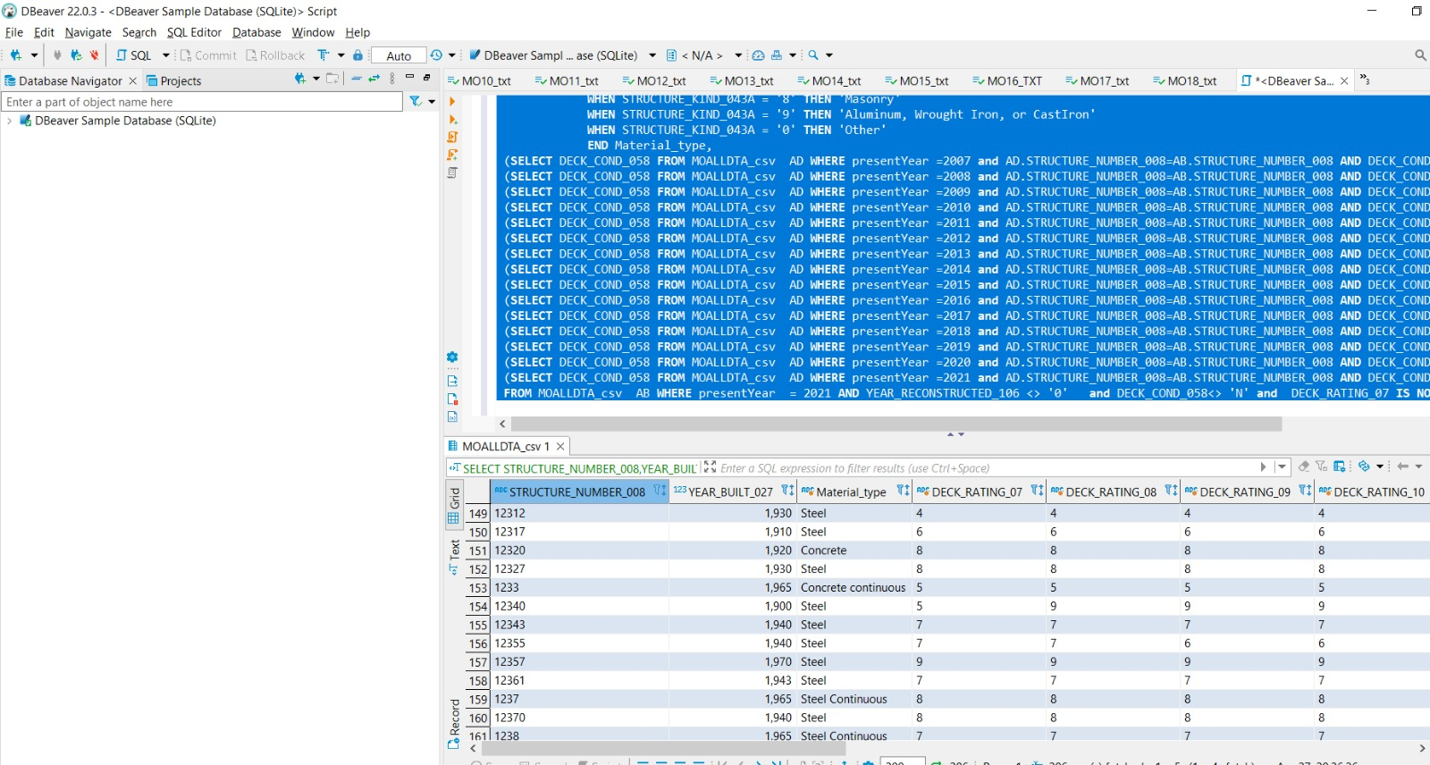
Query6: Similar to query 5 data but for reconstructed bridges:

Slide 19
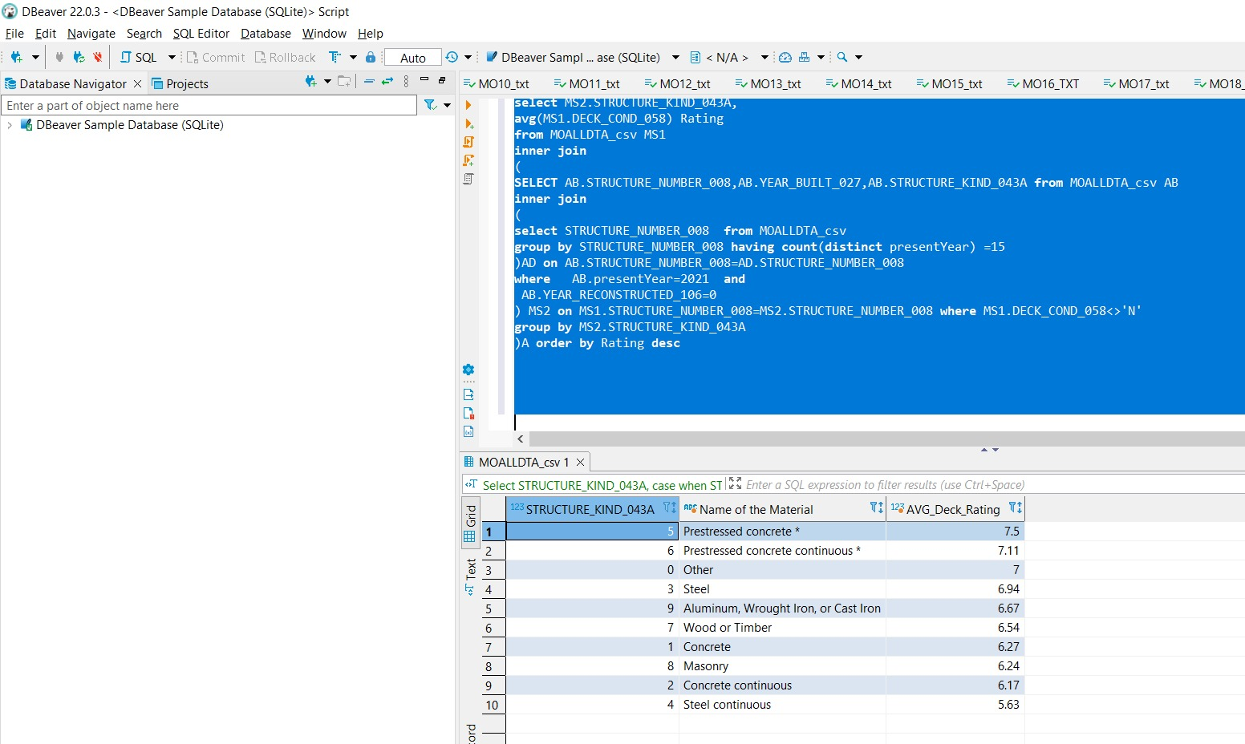
Query 7: Prestressed concrete is the Best material used for bridges with no reconstruction based the deck rating avg

Slide 20


